Slide 1


Fleet Tracker
Instructor: Charles Thompson
System Analyst/ Programmer: Alex Arsenenko
Lead Programmer: Botukh Maksim
DBA: Ngo Yebga Ngos, Aristide Fleurine
Programmer: Sierra Elliott

Slide 2
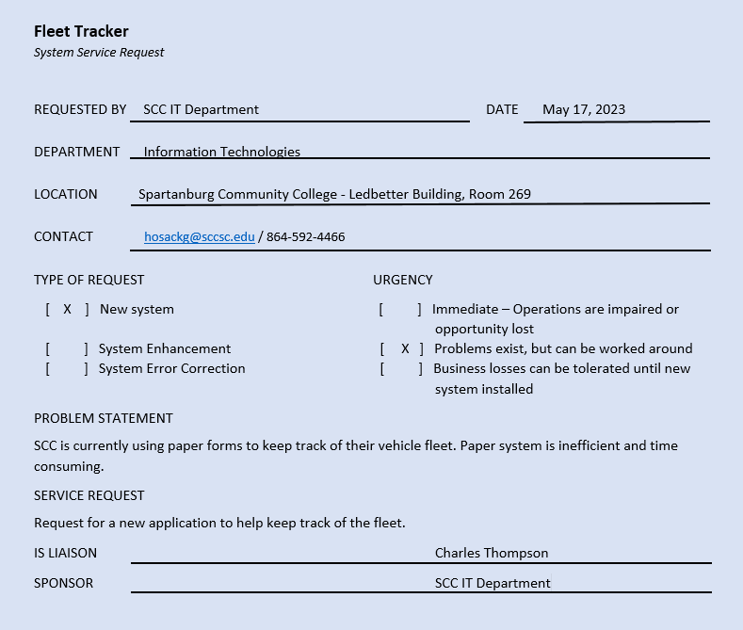
Project Request Form

Slide 3
Fleet Tracker
Manage fleet
Store trip information
Calculate mileage based on trip information
Generate reports
Store inspection information

Slide 4
Admin Dashboard
Manage User
Add / delete / update vehicle information
Manage Vehicle
Add / delete / user vehicle information
Trip Report
Run trip report
Inspection report
Run inspection report
Fleet
View Fleet (Users / Vehicles)
User Screen
Access to user screen

Slide 5
User Screen
Create vehicle inspection report
Create trip report

Slide 6
Languages used
C#
.Net Framework
T-SQL
HTML
JavaScript

Slide 7


Total Lines of code
Presentation Layer
2600+
Data Access Layer
3300 +
Total
5900+

Slide 8
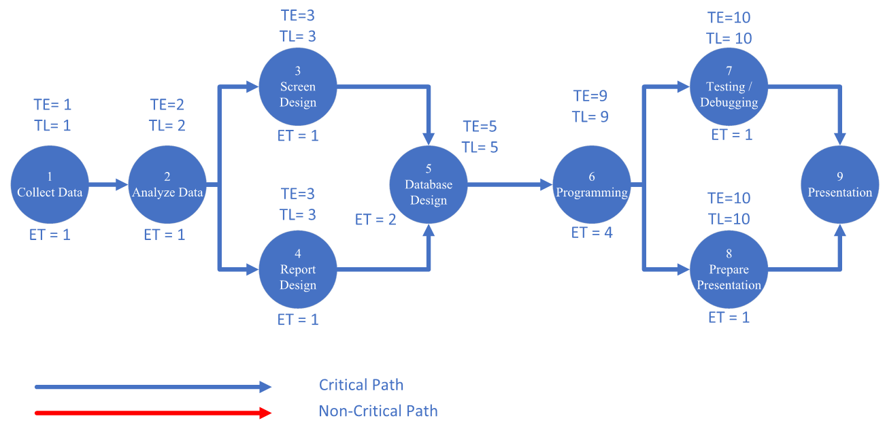
Network Diagram

Slide 9
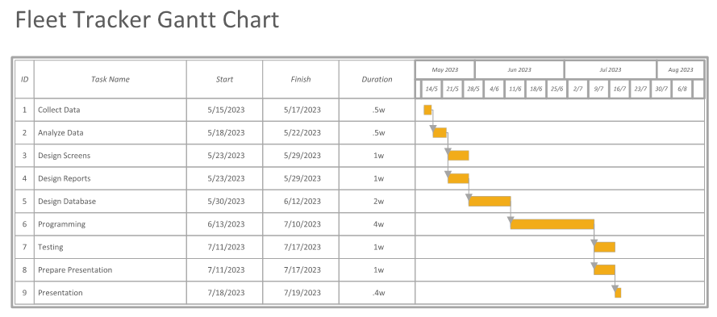
Gantt Chart

Slide 10
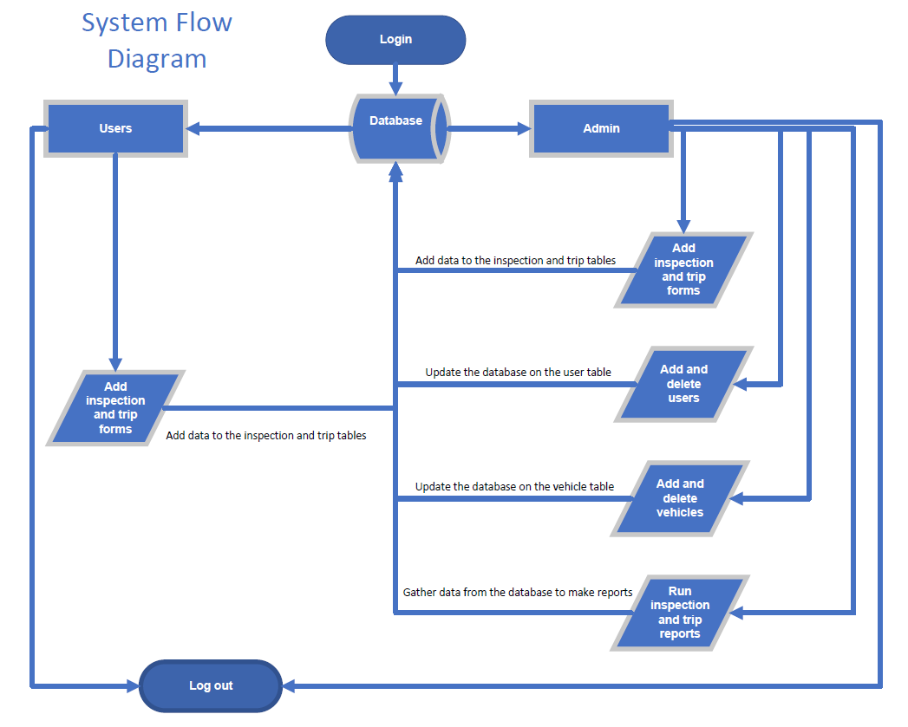


Slide 11
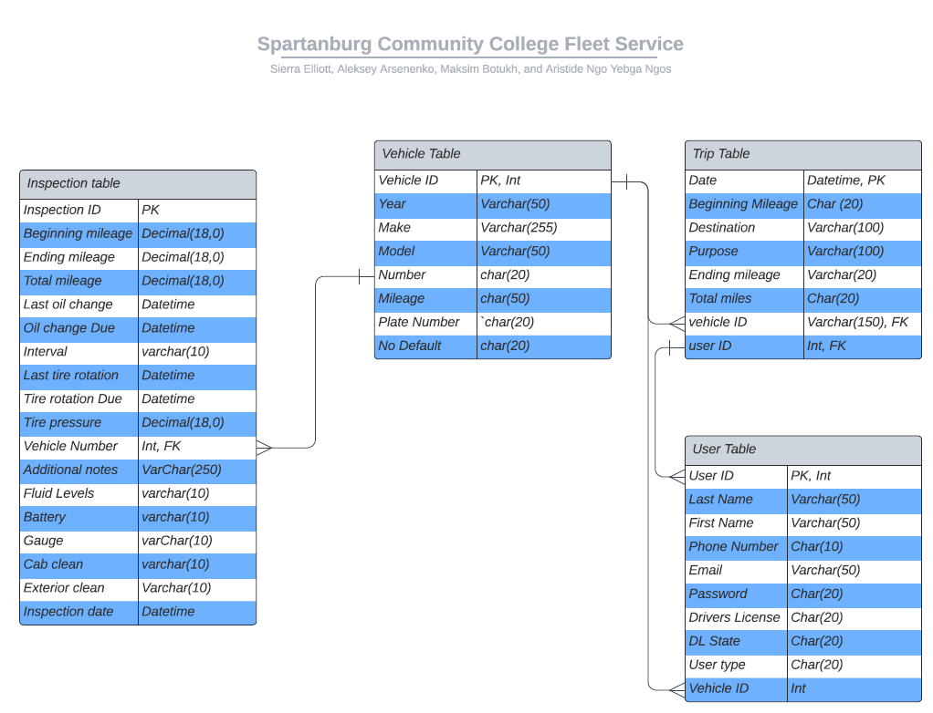
ER Diagram

